Slide 1
Unit – 3 Peek Into History
By:- Jatin Sethi
jsethi@ddn.upes.ac.in

Slide 2
The 70’s and 80’s
SPICE (Simulation Program with Integrated Circuit Emphasis) is a program developed by the University of California, in Berkeley, in order to simulate the electrical characteristics of an integrated circuit.
It was developed and placed in the public domain by its author, Donald O. Pederson, in 1973.
SPICE was originally a teaching tool, and as such rapidly spread to universities worldwide.
There it was used by many students of what was then an emerging discipline: integrated circuits design.
Because it was in the public domain, SPICE could be redistributed, modified, studied.

Slide 3
The 70’s and 80’s
Donald Knuth started to develop TeX during a sabbatical year, in 1978.
TeX is an electronic typography system commonly used for producing high-quality documents.
From the start, Knuth used a licence that today would be considered a free software licence.
When the system was considered sufficiently stable, in 1985, he maintained that licence.
At that time, TeX was on the largest and most well-known systems that could be considered free software.

Slide 4
History of Unix/Linux
Prior to Unix, many operating systems ran collections or “batches” of operations one at a time.
This single-user “batch-processing” approach did not take advantage of the potential processing power and speed of computers
Enter data in
files to be later
processed
Process
Collection or
“Batch” of files
Receive
information of
processed data

Slide 5
History of Unix/Linux
The Unix OS was developed (based on Multics & CTSS operating systems) by Ken Thompson at the AT&T Bell Laboratories in 1969. He wanted to create an multi-user operating system to run “space wars” game.
Ken’s philosophy was to create an operating system with commands or “utilities” that would do one thing well (i.e. UNIX).
The first versions of UNIX were written in “machine-dependent” program (such as PDP-7).
Ken Thompson approached Dennis Ritchie, developer of C language, and in 1973 they compiled UNIX in C to make operating system “portable” to other computers systems.
In the years 1973 and 1974, Unix arrived at many universities and research centres worldwide, with a licence that permitted its use for academic purposes.
Unix became a popular OS among institutions such as colleges & universities through a 4-year “try before you buy” deal.

Slide 6
History of Unix/Linux
1985 Free Software Foundation (FSF) founded by Richard Stallman. Along with other programmers creates the tools needed to make a UNIX compatible OS.
1985 Professor Andy Tannenbaum creates a UNIX like operating system based on System V Unix for the IBM PC & PC/AT computers. It is called Minix.
1989 Richard Stallman releases GPL and GNU software but lacks a free kernel.
1991 Building on the concepts in Minix, Linus Torvalds (Finnish college student) develops Linux along with help from other users on the web.

Slide 7
What Linux is?
Strictly speaking Linux refers to the kernel
GNU/Linux more accurately describes the Operating System. Linux Kernel combined with GNU utilities and libraries
Distribution – GNU/Linux bundled with other applications. Examples Red Hat Linux, Debian, Ubuntu, Suse, Knoppix, etc.
Distributions can be compiled and maintained by an individual or corporation. Can be small (single floppy disk) or span several CD/DVDs.

Slide 8
History of Unix/Linux
On 25 August 1991 (age 21), he announced this system in a Usenet posting to the newsgroup "comp.os.minix.":
Hello everybody out there using minix -
I'm doing a (free) operating system (just a hobby, won't be big and professional like gnu) for 386(486) AT clones. This has been brewing since april, and is starting to get ready. I'd like any feedback on things people like/dislike in minix, as my OS resembles it somewhat (same physical layout of the file-system (due to practical reasons) among other things).
I've currently ported bash(1.08) and gcc(1.40), and things seem to work. This implies that I'll get something practical within a few months, and I'd like to know what features most people would want. Any suggestions are welcome, but I won't promise I'll implement them :-)
Linus (torvalds@kruuna.helsinki.fi)
PS. Yes – it's free of any minix code, and it has a multi-threaded fs. It is NOT portable (uses 386 task switching etc), and it probably never will support anything other than AT-harddisks, as that's all I have :-(.—Linus Torvalds

Slide 9
History of Linux
https://www.youtube.com/watch?v=WVTWCPoUt8w
A video by Linus Torvalds

Slide 10
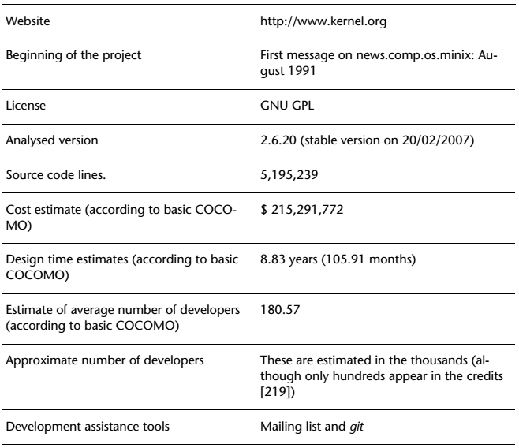
Linux Summary

Slide 11
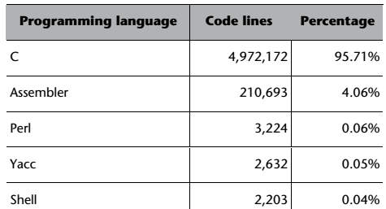
Programming Linux

Slide 12
History of FreeBSD
Berkeley Software Distribution (BSD) is a Unix operating system derivative developed and distributed by the Computer Systems Research Group (CSRG) of the University of California, Berkeley, from 1977 to 1995.
FreeBSD's roots go back to the University of California, Berkeley.
The university acquired a UNIX source license from AT&T. Students of the university started to modify and improve the AT&T Unix and called this modified version Berkeley Unix or BSD, implementing features such as TCP/IP, virtual memory and the Unix File System.
The BSD project was founded in 1976 by Bill Joy.
But since BSD contained code from AT&T Unix, all recipients had to get a license from AT&T first in order to use BSD.
Version 1.0 appeared towards the end of 1993 and was based on 4.3BSD Net/2 and 386BSD. 4.3BSD Net/2 had code that was created in the seventies, when Unix was being developed by AT&T, which, as it turned out, involved a series of legal problems that were not resolved until 1995, when FreeBSD 2.0 was published without the original code developed by AT&T but based on 4.4BSD-Lite, a light version of 4.4BSD (in which many of the modules had been eliminated for legal reasons, apart from the fact that the port for Intel systems was still incomplete) that was released by the University of California.

Slide 13
FreeBSD
The main objective of the FreeBSD project is the creation of an operating system that can be used without any type of obligations or ties, but that has all the advantages of code availability and is carefully processed to guarantee the quality of the product.
The user has the liberty to do whatever they like with the software, either by modifying it according to their wishes or by redistributing it in an open form or even in a closed form, under the terms that they wish, with or without modifications.
As the name itself indicates, the FreeBSD project is based, therefore, on the philosophy of BSD licenses.
FreeBSD distributes its software in two forms: on the one hand, the ports, a system that downloads the source codes, compiles them and installs the application in the local computer, and on the other, the packages, which are simply the source codes of the precompiled ports and, therefore, in binary. The most important advantage of the ports over the packages is that the former allow the user to configure and optimise the software for their computer. On the other hand, in the package system, as they are already precompiled, it takes much less time to install the software.

Slide 14
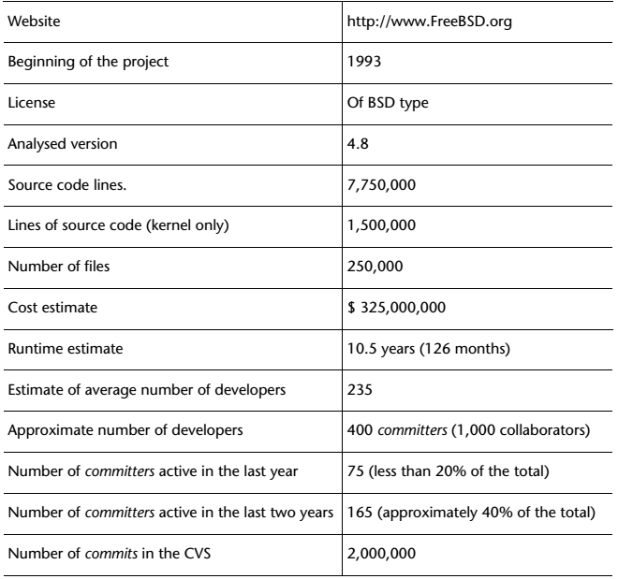
Summary of FreeBSD

Slide 15
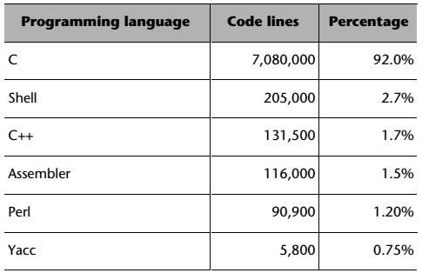
Programming Languages Used in FreeBSD

Slide 16
KDE
Unix followers were quick to notice the outstanding success of Windows 95 and, given that Unix-like environments did not have systems that were as intuitive whilst still being free, they decided to get to work. The KDE K Desktop Environment project was born from this effort in 1996; it was designed by Matthias Ettrich (creator of LyX, an editing program in the TeX typeset) and other hackers.
Aim of the KDE Project:
To provide Unix-like systems with a user-friendly environment that was, at the same time, open, stable, trustworthy and powerful.
To develop a set of libraries for writing standard applications on a graphical system for Unix X11.
To create a series of applications that would allow the user to achieve their objectives effectively and efficiently.
The KDE league:
SuSe (now part of Novtell)
Mandriva Distribution
Trolltech

Slide 17
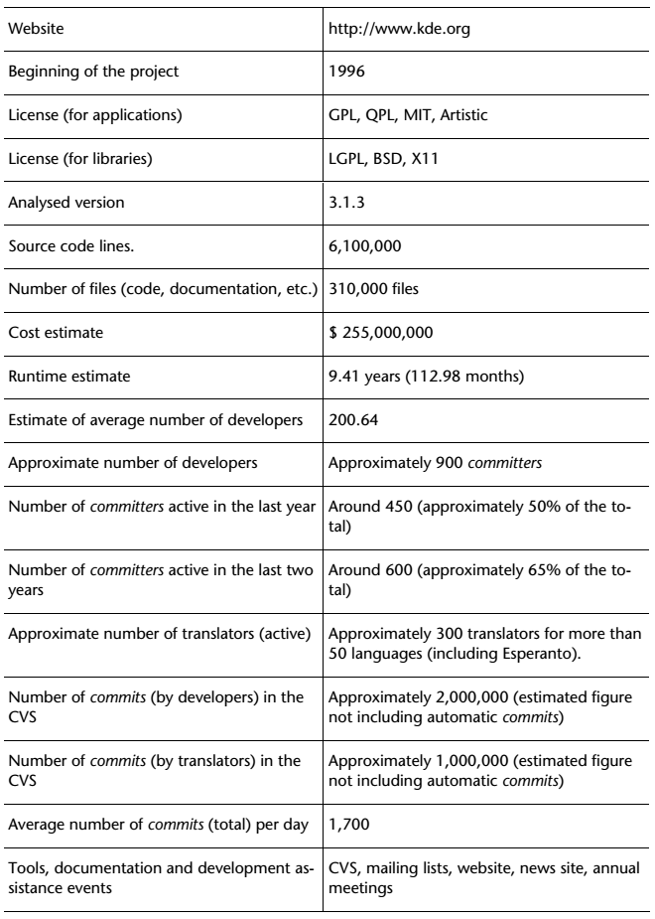
Summary of KDE

Slide 18
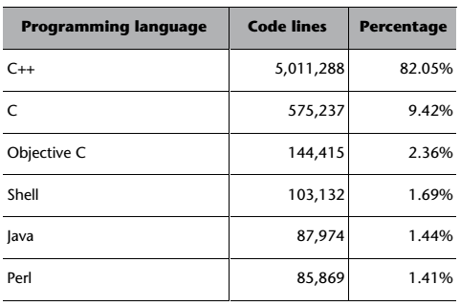
Programming Languages used in KDE

Slide 19
GNOME and History
The main objective of the GNOME project is to create a desktop system for the end user that is complete, free and easy to use. Likewise, the idea is for GNOME to be a very powerful platform for developers. The initials GNOME stand for GNU Network Object Model Environment. From its name, we see that GNOME is part of the GNU project. Currently, all the code contained in GNOME must be under a GNU GPL or a GNU LGPL license.
GNOME was started on August 15th 1997 by Miguel de Icaza and Federico Mena as a free software project to develop a desktop environment and applications for it. It was founded in part because K Desktop Environment, an already existing free software desktop environment, relied on the Qt widget toolkit which used a proprietary software license until version 2.0 (June 1999).In place of Qt, the GTK+ toolkit was chosen as the base of GNOME. GTK+ uses the GNU Lesser General Public License (LGPL), a free software license that allows software linking to it to use a much wider set of licenses, including proprietary software licenses. GNOME itself is licensed under the LGPL for its libraries, and the GNU General Public License (GPL) for its applications

Slide 20
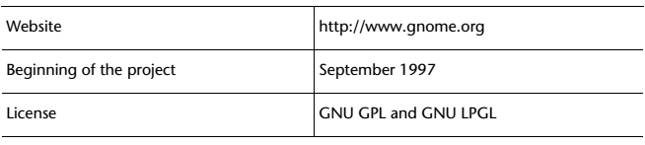
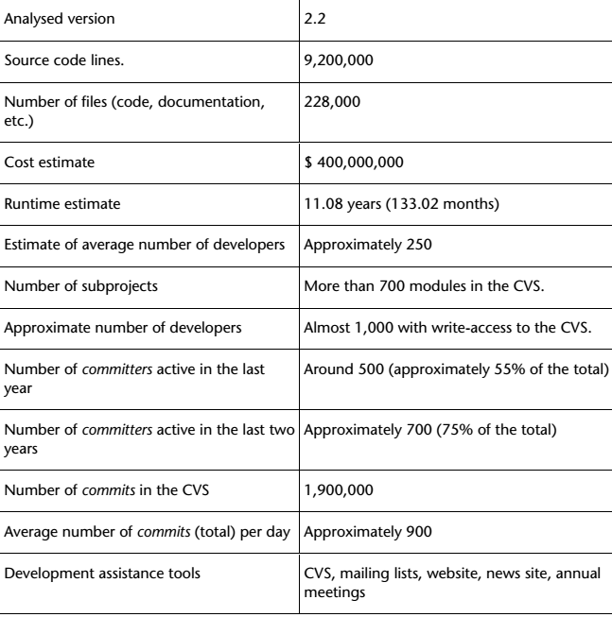
Summary of GNOME

Slide 21
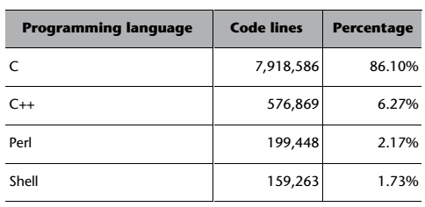

Programming Languages Used in GNOME

Slide 22
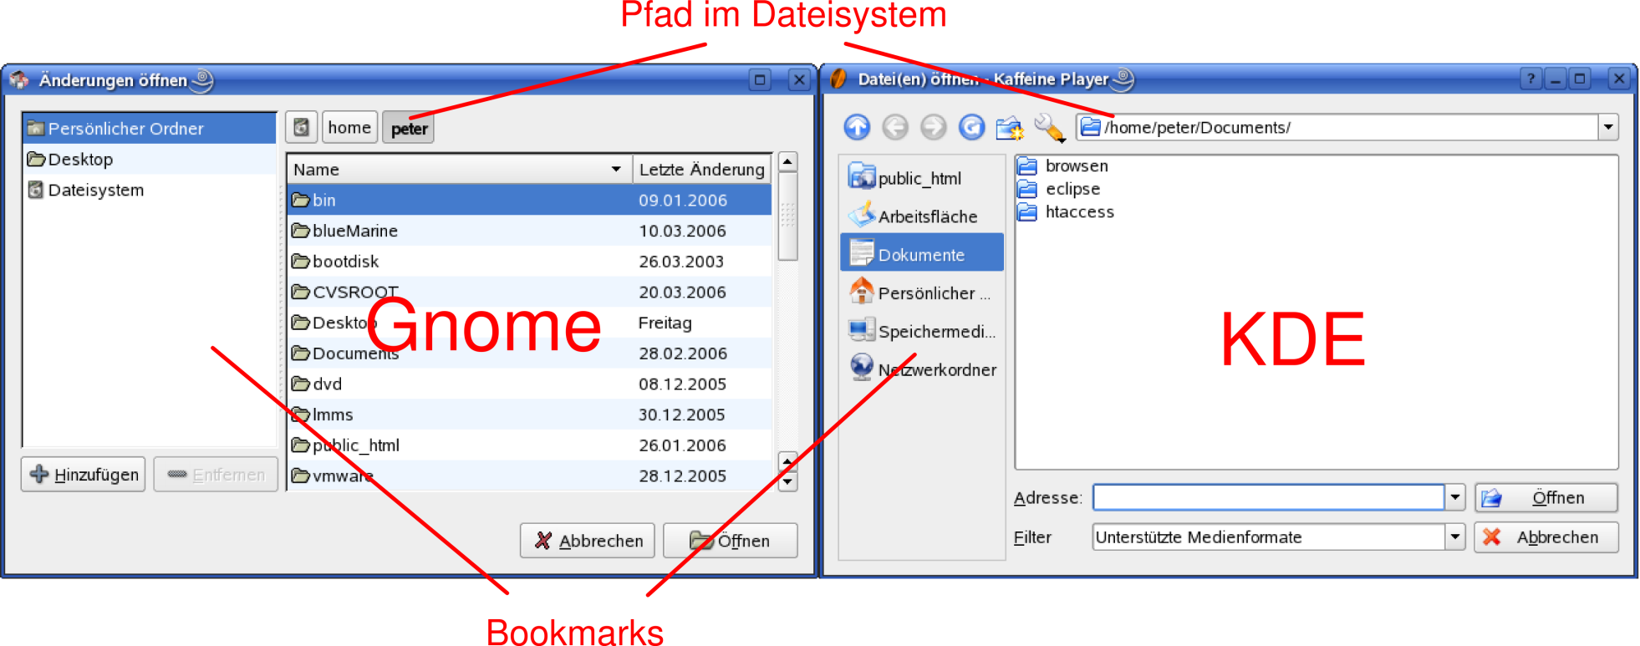
GNOME and KDE

Slide 23
Apache
The Apache HTTP Server is the world's most widely used web server software. Originally based on the NCSA HTTPd server, development of Apache began in early 1995 after work on the NCSA code stalled. Apache played a key role in the initial growth of the World Wide Web, quickly overtaking NCSA HTTPd as the dominant HTTP server, and has remained most popular since April 1996. In 2009, it became the first web server software to serve more than 100 million websites.
Apache is developed and maintained by an open community of developers under the auspices of the Apache Software Foundation. Most commonly used on a Unix-like system (usually GNU/Linux), the software is available for a wide variety of operating systems, besides Unix and GNU+Linux, including eComStation, Microsoft Windows, NetWare, OpenVMS, OS/2, and TPF. Released under the Apache License, Apache is free and open-source software.
As of June 2013, Apache was estimated to serve 54.2% of all active websites and 53.3% of the top servers across all domains.

Slide 24
History of Apache
In March 1989, Tim Berners Lee, an English scientist that worked in the CERN (Switzerland) proposed a new method for managing the huge amount of information from the CERN projects. The method would be a network of hyperlinked documents (hypertext, as Ted Nelson had called it already in 1965); the WWW was born. However, it was not until November 1990 that the first WWW software was unveiled: a package called the World Wide Web included a web browser with a graphic interface and a WYSIWYG ("what you see is what you get") editor. Two years later, the list of WWW servers had approximately thirty entries, including NCSA HTTPd.
The real history of Apache began when Rob Mc Cool left the NCSA in March 1995. Apache 0.2 would be born on 18th March 1995, based on the NCSA HTTPd 1.3 server, built by Rob McCool himself while he was at NCSA. During those first months, Apache was a collection of patches applied to the NCSA server, until Robert Thau launches Shambhala 0.1, an almost complete reimplementation that already included the API for the modules that subsequently turned out to be so successful.
The first stable version of Apache did not appear until January 1996, when Apache 1.0 was released, which included the loading of modules in test-mode runtime, as well as other interesting functions. In the meantime, in June 1998, IBM decided that, instead of developing its own HTTP, it would use Apache as the engine of its product WebSphere. This was interpreted as a huge endorsement for the Apache project.

Slide 25
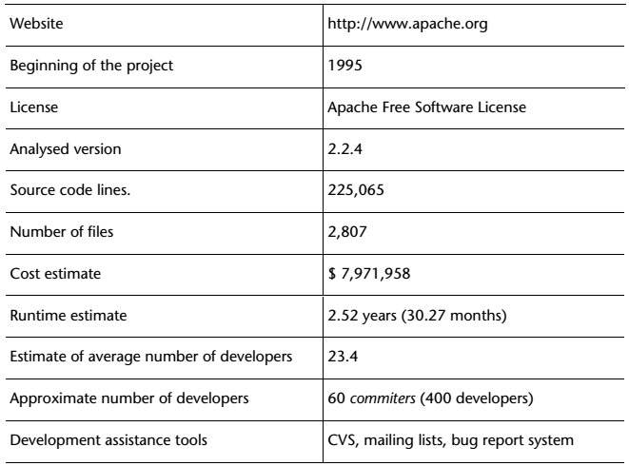
Summary of Apache

Slide 26
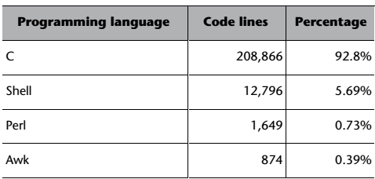
Programming Languages Used in Apache

Slide 27
History of Mozilla
As was the case with Apache's predecessor, it was the NCSA ( NEXTGENERATION COMMUNICATOR SOURCE CODE) where the first complete Internet browser, Mosaic, was "born" in 1993.
The development team, with Marc Andreessen and Jim Clark at the helm, created a small company in order to write, starting from zero (as there were problems with the copyright on the code of Mosaic and the technical design of the program had its limitations.
Netscape Communicator browser, which was, unarguably, the leader of the market of Internet browsers until the arrival of Microsoft Internet Explorer.
Around 1997, Netscape's market share had dropped sharply due to the spread of Microsoft Explorer; consequently, Netscape Inc. was studying new ways of recovering its previous dominance.
In January 1998, Netscape Inc. officially announced that it would publicly release the source code of its browser, marking an extremely important milestone within the short history of free software: a company was going to publish the whole of the source code of an application that had been a commercial product up until then, under a free software license.
The Mozilla project was created in 1998 with the release of the Netscape browser suite source code. At the end of the process, more than one million and a half lines of source code were released.

Slide 28
History of Mozilla
After several years of development, Mozilla 1.0, the first major version, was released in 2002.
The Netscape Public License (NPL) was created: a license that was based on the basic principles of free software licenses, but that also gave certain additional rights to Netscape Inc, which also made it a non-free license, from the perspective of the Free Software Foundation. When the draft of the NPL was published for public discussion, the clause providing additional rights to Netscape was heavily criticised. Netscape Inc. reacted quickly in response to these criticisms and created an additional license, the Mozilla Public License (MPL), which was identical to the NPL, except in that Netscape had no additional rights.
The first version of Phoenix (later renamed to Firefox) was also released by Mozilla community members that year with the goal of providing the best possible browsing experience to the widest possible set of people.
In 2003, the Mozilla project created the Mozilla Foundation, an independent non-profit organization supported by individual donors and a variety of companies.
On 15th July 2003, Netscape Inc. (now the property of America On Line) announced that it was no longer going to develop the Netscape browser
Firefox 1.0 was released in 2004 and became a big success — in less than a year, it was downloaded over 100 million times.
In 2013, Firefox OS was launched to unleash the full power of the Web on smartphones and once again offer control and choice to a new generation of people coming online.
Mozilla also celebrated its 15th anniversary in 2013.

Slide 29
More about Mozilla
The Mozilla project hosts various independent applications, the most notable of which include Mozilla Firefox (web browser), which is undoubtedly the most well-known, Mozilla Thunderbird (email and news client), Mozilla Sunbird (calendar), Mozilla Nvu (HTML editor), Camino (web browser designed for Mac OS X) and Bugzilla (web-based bug-tracker tool).

Slide 30
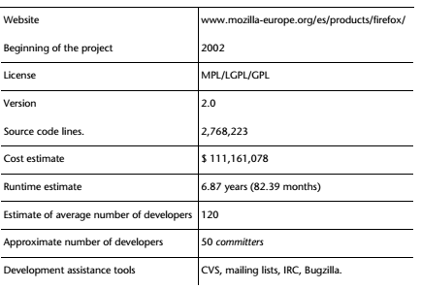
Summary

Slide 31
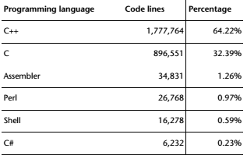

Programming languages used in Mozilla

Slide 32
Open Office
OpenOffice.org is one of the star applications in the current free software scene.
It is a multiplatform office application suite that includes the key applications in an office desktop environment, such as a word processor (Writer), a spreadsheet (Calc), a presentation program (Impress), a graphics editor (Draw), a tool for creating and editing mathematical formulae (Math) and, finally, an HTML language editor (included in Writer).
The interface provided by OpenOffice.org is homogeneous and intuitive, with an appearance and functionalities similar to those of other office applications, especially the one that is most widely used today, Microsoft Office.
Written in C++, OpenOffice.org includes Java's API and has its own components for embedded systems, which makes it possible to include, for example, tables from a spreadsheet in the word processor in a very simple and intuitive way.

Slide 33
History of Open Office
In mid-1980s, the company StarDivision was founded in the Federal Republic of Germany, with the principal aim of creating an office application suite: StarOffice.
In summer 1999, SUN Microsystems decided to purchase the company StarDivision and make a significant commitment to StarOffice, with the clear intention of wresting away part of the market share conquered by Microsoft at that time.
In June 2000, the company launched version 5.2 of StarOffice, which could be downloaded gratis from the Internet.
However, StarOffice's success was limited, as the market was already strongly dominated by Microsoft's office package.
SUN decided to change its strategy and, as occurred with Netscape and the Mozilla project, decided to take advantage of free software to gain importance and implement its systems. Consequently, the future versions of StarOffice (a proprietary product of SUN) would be created using OpenOffice.org (a free product) as a source, respecting the application programming interfaces (API) and the file formats and serving as the standard implementation.

Slide 34
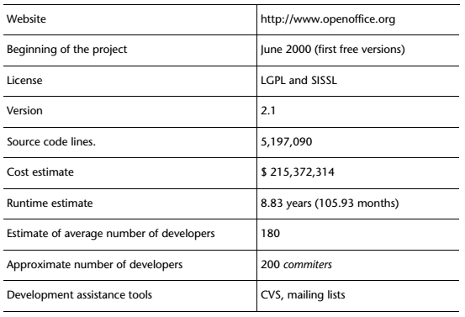
Summary of Open Office

Slide 35
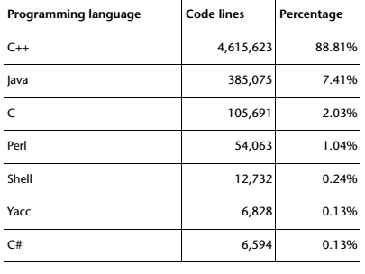
Programming Languages used in Open Office

Slide 36
Red Hat Linux
Red Hat Linux was one of the first commercial distributions of GNU/Linux. Today, it is probably one of the most well-known, and certainly the one that can be considered the "canonical" of all the commercial distributions.
Red Hat Software Inc. was founded by Bob Young and Marc Ewing in 1994. The main objective was to compile and commercialize a GNU/Linux distribution that was called (and is still called) Red Hat Linux.
Version 1.0 of this distribution was born in the summer of 1995. A few months later, in autumn, version 2.0, which included RPM technology.
In 1998, version 5.2 of Red Hat was issued to the great public.
In September 2003, Red Hat decided to concentrate its development work on the corporate version of its distribution and delegated the common version to Fedora Core, an open source project independent of Red Hat.
In June 2006, Red Hat purchased the company JBoss, Inc., becoming the company in charge of developing the most important open source applications server, J2EE.

Slide 37
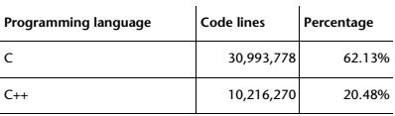
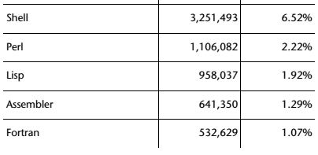
Programming Languages Used

Slide 38
Java and its History
Java is a general-purpose computer programming language that is concurrent, class-based, object-oriented, and specifically designed to have as few implementation dependencies as possible.
It is intended to let application developers "write once, run anywhere" (WORA), meaning that compiled Java code can run on all platforms that support Java without the need for recompilation.
Java applications are typically compiled to bytecode that can run on any Java virtual machine (JVM) regardless of computer architecture.

Slide 39
History of Java
Java was conceived by James Gosling, Patrick Naughton, Chris Warth, Ed Frank, and Mike Sheridan (Green Team) at Sun Microsystems, Inc. in 1991. Computers were everywhere and were the driving force behind many of the products in the home: the VCR, the microwave oven, the security system, and the stereo system.
It took 18 months to develop the first working version.
This language was initially called “Oak,” but was renamed “Java” in 1995.
Between the initial implementation of Oak in the fall of 1992 and the public announcement of Java in the spring of 1995, many more people contributed to the design and evolution of the language.
Bill Joy, Arthur van Hoff, Jonathan Payne, Frank Yellin, and Tim Lindholm were key contributors to the maturing of the original prototype.

Slide 40
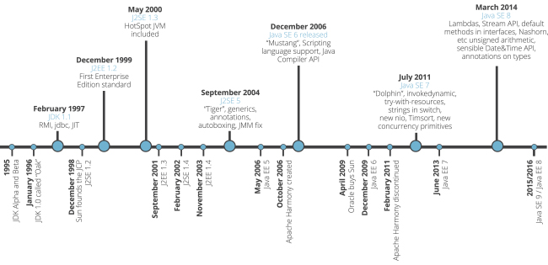
History of Java

Slide 41
PHP and its History
PHP is a server-side scripting language designed for web development but also used as a general-purpose programming language.
PHP as it's known today is actually the successor to a product named PHP/FI. Created in 1994 by Rasmus Lerdorf, the very first incarnation of PHP was a simple set of Common Gateway Interface (CGI) binaries written in the C programming language.
Originally used for tracking visits to his online resume, he named the suite of scripts "Personal Home Page Tools," more frequently referenced as "PHP Tools." Over time, more functionality was desired, and Rasmus rewrote PHP Tools, producing a much larger and richer implementation.
This new model was capable of database interaction and more, providing a framework upon which users could develop simple dynamic web applications such as guestbooks.
In June of 1995, Rasmus eleased the source code for PHP Tools to the public, which allowed developers to use it as they saw fit. This also permitted - and encouraged - users to provide fixes for bugs in the code, and to generally improve upon it.
In September of that year, Rasmus expanded upon PHP and - for a short time - actually dropped the PHP name. Now referring to the tools as FI (short for "Forms Interpreter")
The code got another complete makeover, and in April of 1996, combining the names of past releases, Rasmus introduced PHP/FI. This second-generation implementation began to truly evolve PHP from a suite of tools into a programming language in its own right. It included built-in support for DBM, mSQL, and Postgres95 databases, cookies, user-defined function support, and much more. That June, PHP/FI was given a version 2.0 status.

Slide 42
Eclipse and its history
The Eclipse platform consists of an open and extensible IDE (integrated development environment). An IDE is a program consisting of a set of tools that are useful for a software developer.
The basic elements of an IDE include a code editor, a compiler/interpreter and a debugger. Eclipse is an IDE in Java and provides numerous software development tools. It also supports other programming languages, such as C/C++, Cobol, Fortran, PHP or Python. Plug-ins can be added to the basic platform of Eclipse to increase the functionality.
A lot of Eclipse's programming was carried out by IBM before the Eclipse project was created as such. Eclipse's predecessor was VisualAge and it was built using Smalltalk in a development environment called Envy.
After Java appeared in the nineties, IBM developed a virtual machine that worked with both Smalltalk and Java. The rapid growth of Java and its advantages with the focus on an Internet that was expanding heavily forced IBM to consider abandoning this dual virtual machine and to build a new platform based on Java from scratch. The final product was Eclipse, which had already cost IBM approximately 40 million dollars in 2001.
Towards the end of 2001, IBM, along with Borland, created the non-profit Eclipse foundation, thereby opening up to the open source world. This consortium was gradually joined by important global software development companies: Oracle, Rational Software, Red Hat, SuSE, HP, Serena, Ericsson and Novell, among others.
There are two significant absences: Microsoft and Sun Microsystems. Microsoft was excluded due to its monopoly of the market and Sun Microsystems had its own IDE, constituting Eclipse's main competition: NetBeans. In fact, the Eclipse name was chosen because the aim was to create an IDE able to "eclipse Visual Studio" (Microsoft) and to "eclipse the sun" (Sun Microsystems).

